Slide 1
Black-Box vs. White-Box Testing
Instructor
Dr. Sultan S. Alqahtani
ssalqahtani@imamu.edu.sa
Note: These are a slightly modified version of Lecture 21-24 of Dr. Abdul Rauf Malik., and Software Testing materials from https://users.encs.concordia.ca/~gregb/home/comp354-w2019.html and http://galaxy.lamar.edu/~sandrei/CPSC-4360-01/

Slide 2
Topics covered
Software Testing
Testing vs. Debugging
White-box vs. Black-box testing
Structural Testing
Control Flow Graph (CFG)
Path Base Testing
Functional Testing

Slide 3
Where are we now?
Requirement
Analysis
Design
Implement
Test
Evaluating the System

Slide 4
Software Testing
“Testing is the process of executing a program with the intention of finding errors.” – Myers

Slide 5
Software errors, faults, failures and incidents
An error (or mistake) is something people make. It is a slip-up or inappropriate decision by a software developer (or other project member) that leads to the introduction of a fault or defect.
A fault (defect, bug) is the result of an error: inaccurate requirements text, erroneous design, buggy source code etc. It is a flaw in any aspect of the system that contributes, or may potentially contribute, to the occurrence of one or more failures.
A failure (incident) is the program’s actual incorrect or missing behavior. It occurs when a fault executes. A fault won’t yield a failure without the conditions that trigger it.
An incident is a characteristic of a failure that helps you recognize that the program has failed.

Slide 6
Testing vs. Debugging
Testing is concerned with confirming the presence of faults
Debugging is concerned with locating and repairing these faults

Slide 7
Test Cases
Work product (artifact) of software development
A good test case is one that has a high probability of finding an as-yet-undiscovered bug.
Each test case consists of the following (ideally):
Identifier
Statement of purpose
Preconditions
Inputs and expected outputs
Expected post-conditions
Execution history (date, tester, version, etc.)

Slide 8
Approaches to derive test cases
Structural (white-box)
Derived from code documentation
Test coverage metrics
Functional (black-box)
Derived from specs
Reusable even if code changes

Slide 9
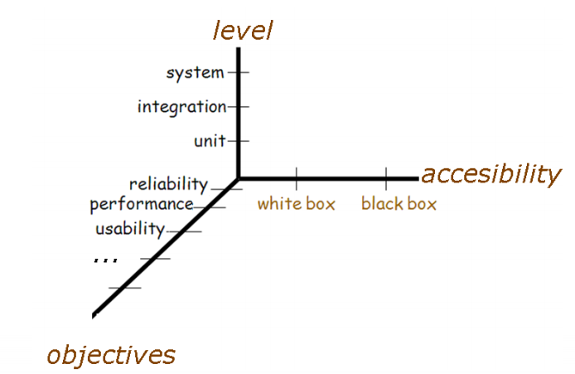
Dimensions of Testing

Slide 10
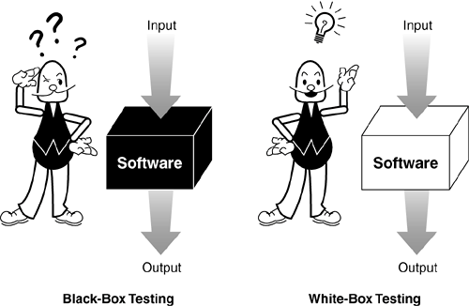
White-box vs. Black-box testing
Black box testing can detect errors such as incorrect functions, missing functions
It cannot detect design errors, coding errors, unreachable code, hidden functions
White box testing can detect errors such as logic errors, design errors
It cannot detect whether the program is performing its expected functions, missing functionality.
Both methods of testing are required.

Slide 11
White-box vs. Black-box testing
White-box testing | Black-box testing
Test structure | Test function
Find design and code errors | Can find requirements specification errors
Can’t find missing functions | Can find missing functions

Slide 12
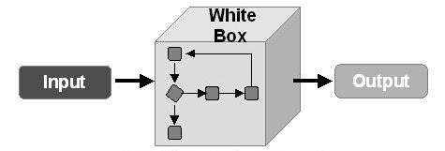
Structural (White-box) testing
Test Engineers have access to the source code.
Typical at the Unit Test level as the programmers have knowledge of the internal logic of code.
Most of the testing techniques are based on Control Flow Graph (denoted as CFG) of a code fragment.

Slide 13
Control Flow Graph: Introduction
An abstract representation of a structured program/function/method.
Consists of two major components:
Node:
Represents a stretch of sequential code statements with no branches.
Directed Edge (also called arc):
Represents a branch, alternative path in execution.
Path:
A collection of Nodes linked with Directed Edges.

Slide 14
Simple Examples
Statement1;
Statement2;
Statement3;
Statement4;
Can be represented as one node as there is no branch.
1
CFG
Statement1;
Statement2;
if X < 10 then
Statement3;
Statement4;
1
T
3
1
2
2
3
F
4
CFG
4

Slide 15
More Examples
if X > 0 then
Statement1; else Statement2;
1
T
2
2
1
4
3
3
F
CFG
F
while X < 10 {
Statement1; X++; }
1
2
1
2
3
4
T
3
CFG
Question: Why is there a node 4 in both CFGs?

Slide 16
Notation Guide for CFG
A CFG should have:
1 entry arc (known as a directed edge, too).
1 exit arc.
All nodes should have:
At least 1 entry arc.
At least 1 exit arc.
A Logical Node that does not represent any actual statements can be added as a joining point for several incoming edges.
Represents a logical closure.
Example:
Node 4 in the if-then-else example from previous slide.

Slide 17
Example: Minimum Element
min = A[0];
I = 1;
while (I < N) {
if (A[I] < min)
min = A[I];
I = I + 1;
}
print min
1
1
2
2
F
T
3
3
4
F
T
5
5
4
6
6
CFG
Note: The CFG is INCOMPLETE. Try to complete it

Slide 18
Number of Paths through CFG
Given a program, how do we exercise all statements and branches at least once?
Translating the program into a CFG, an equivalent question is:
Given a CFG, how do we cover all arcs and nodes at least once?
Since a path is a trail of nodes linked by arcs, this is similar to ask:
Given a CFG, what is the set of paths that can cover all arcs and nodes?

Slide 19
Example
T
3
1
2
1
F
4
CFG
CFG
Only one path is needed:
[ 1 ]
Two paths are needed:
[ 1 – 2 – 4 ]
[ 1 – 2 – 3 – 4 ]
T
2
1
4
Two paths are needed:
[ 1 – 2 – 4 ]
[ 1 – 3 – 4 ]
3
F
CFG

Slide 20
White Box Testing: Path Based
A generalized technique to find out the number of paths needed (known as cyclomatic complexity) to cover all arcs and nodes in CFG.
Steps:
Draw the CFG for the code fragment.
Compute the cyclomatic complexity number C, for the CFG.
Find at most C paths that cover the nodes and arcs in a CFG, also known as Basic Paths Set;
Design test cases to force execution along paths in the Basic Paths Set.

Slide 21
Path Based Testing: Step 1
min = A[0];
I = 1;
while (I < N) {
if (A[I] < min)
min = A[I];
I = I + 1;
}
print min
1
2
F
T
3
F
T
5
4
6
CFG

Slide 22
Path Base Testing: Step 2
Cyclomatic complexity =
The number of ‘regions’ in the graph; OR
V(G) = P + 1
P is the number of predicates + 1. OR
V(G) = E – N + 2
E number of edges
N number of nodes
1
2
F
T
3
F
T
5
4
6
CFG

Slide 23
Path Base Testing: Step 2
1
Region: Enclosed area in the CFG.
Do not forget the outermost region.
In this example:
3 Regions (see the circles with different colors).
Cyclomatic Complexity = 3
Alternative way in next slide.
2
F
T
3
F
T
5
4
6
CFG

Slide 24
Path Base Testing: Step 2
Predicates:
Nodes with multiple exit arcs.
Corresponds to branch/conditional statement in program.
In this example:
Predicates = 2
(Node 2 and 3)
Cyclomatic Complexity
= 2 + 1
= 3
Alternative way in next slide.
1
2
F
T
3
F
T
5
4
6
CFG

Slide 25
Path Base Testing: Step 2
Number of nodes and edges:
N = 6
E = 7
In this example:
Cyclomatic Complexity
= 7 – 6 + 2
= 3
1
2
F
T
3
F
T
5
4
6
CFG

Slide 26
Path Base Testing: Step 3
Independent path:
An executable or realizable path through the graph from the start node to the end node that has not been traversed before.
Must move along at least one arc that has not been yet traversed (an unvisited arc).
The objective is to cover all statements in a program by independent paths.
The number of independent paths to discover <= cyclomatic complexity number.
Decide the Basis Path Set:
It is the maximal set of independent paths in the flow graph.
NOT a unique set.

Slide 27
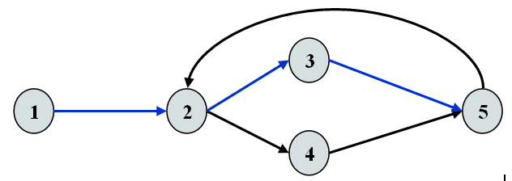
Example
Example
1-2-3-5 can be the first independent path; 1-2-4-5 is another; 1-2-3-5-2-4-5 is one more.
There are only these 3 independent paths. The basis path set is then having 3 paths.
Alternatively, if we had identified 1-2-3-5-2-4-5 as the first independent path, there would be no more independent paths.
The number of independent paths therefore can vary according to the order we identify them.

Slide 28
Path Base Testing: Step 3
Cyclomatic complexity = 3.
Need at most 3 independent paths to cover the CFG.
In this example:
[ 1 – 2 – 6 ]
[ 1 – 2 – 3 – 5 – 2 – 6 ]
[ 1 – 2 – 3 – 4 – 5 – 2 – 6]
1
2
F
T
3
F
T
5
4
6
CFG
Notes:
Dirichlet Principle: Given n boxes and m>n objects, at least one box must contain more than one object.
Example: Lamar elevator: Given Lamar University Library building, if there are 8 people in the elevator at the ground floor, then there exists a floor where two people will get off. (knowing that the Lamar University Library building has 8 floors – including ground floor).

Slide 29
Path Base Testing: Step 4
Prepare a test case for each independent path.
In this example:
Path: [ 1 – 2 – 6 ]
Test Case: A = { 5, …}, N = 1
Expected Output: 5
Path: [ 1 – 2 – 3 – 5 – 2 – 6 ]
Test Case: A = { 5, 9, … }, N = 2
Expected Output: 5
Path: [ 1 – 2 – 3 – 4 – 5 – 2 – 6]
Test Case: A = { 8, 6, … }, N = 2
Expected Output: 6
These tests will result a complete decision and statement coverage of the code.
min = A[0];
I = 1;
while (I < N) {
if (A[I] < min)
min = A[I];
I = I + 1;
}
print min
Try to verify that the test cases actually force execution along a desired path.

Slide 30
Another Example
int average (int[ ] value, int min, int max, int N) {
int i, totalValid, sum, mean;
i = totalValid = sum = 0;
while ( i < N && value[i] != -999 ) {
if (value[i] >= min && value[i] <= max){
totalValid += 1; sum += value[i];
}
i += 1;
}
if (totalValid > 0)
mean = sum / totalValid;
else
mean = -999;
return mean;
}

Slide 31
Step 1: Draw CFG
int average (int[ ] value, int min, int max, int N) {
int i, totalValid, sum, mean;
i = totalValid = sum = 0;
while ( i < N && value[i] != -999 ) {
if (value[i] >= min && value[i] <= max){
totalValid += 1; sum += value[i];
}
i += 1;
}
if (totalValid > 0)
mean = sum / totalValid;
else
mean = -999;
return mean;
}
1
2
4
3
5
6
7
8
9
10
11

Slide 32
Step 1: Draw CFG
9
T
8
11
F
F
10
F
1
2
T
3
T
4
T
5
T
6
F
F
7
CFG

Slide 33
Step 2: Find Cyclomatic Complexity
9
T
8
11
F
F
10
F
1
2
T
3
T
4
T
5
T
6
F
F
Regions = 6
Cyclomatic Complexity = 6
7
CFG

Slide 34
Step 2: Find Cyclomatic Complexity
9
T
8
11
F
F
10
F
1
2
T
3
T
4
T
5
T
6
F
F
Predicates = 5
Cyclomatic Complexity = 5 + 1 = 6
7
CFG

Slide 35
Step 2: Find Cyclomatic Complexity
9
T
8
11
F
F
10
F
1
2
T
3
T
4
T
5
T
6
N = 11
E = 15
Cyclomatic Complexity = 15 – 11 + 2 = 6
F
F
7
CFG

Slide 36
Step 3: Find Basic Path Set
Find at most 6 independent paths.
Usually, simpler path == easier to find a test case.
However, some of the simpler paths are not possible (not realizable):
Example: [ 1 – 2 – 8 – 9 – 11 ].
Not Realizable (i.e., impossible in execution).
Verify this by tracing the code.
Basic Path Set:
[ 1 – 2 – 8 – 10 – 11 ].
[ 1 – 2 – 3 – 8 – 10 – 11 ].
[ 1 – 2 – 3 – 4 – 7 – 2 – 8 – 10 – 11 ].
[ 1 – 2 – 3 – 4 – 5 – 7 – 2 – 8 – 10 – 11 ].
[ 1 – ( 2 – 3 – 4 – 5 – 6 – 7 ) – 2 – 8 – 9 – 11 ].
In the last case, ( … ) represents possible repetition.

Slide 37
Step 4: Derive Test Cases
Path:
[ 1 – 2 – 8 – 10 – 11 ]
Test Case:
value = {…} irrelevant.
N = 0
min, max irrelevant.
Expected Output:
average = -999
... i = 0;
while (i < N &&
value[i] != -999) {
......
}
if (totalValid > 0)
......
else
mean = -999;
return mean;
1
2
8
10
11

Slide 38
Step 4: Derive Test Cases
Path:
[ 1 – 2 – 3 – 8 – 10 – 11 ]
Test Case:
value = {-999}
N = 1
min, max irrelevant
Expected Output:
average = -999
... i = 0;
while (i < N &&
value[i] != -999) {
......
}
if (totalValid > 0)
......
else
mean = -999;
return mean;
1
2
3
8
10
11

Slide 39
Step 4: Derive Test Cases
Path:
[ 1 – 2 – 3 – 4 – 7 – 2 – 8 – 10 – 11 ]
Test Case:
A single value in the value[ ] array which is smaller than min.
value = { 25 }, N = 1, min = 30, max irrelevant.
Expected Output:
average = -999
Path:
[ 1 – 2 – 3 – 4 – 5 – 7 – 2 – 8 – 10 – 11 ]
Test Case:
A single value in the value[ ] array which is larger than max.
value = { 99 }, N = 1, max = 90, min irrelevant.
Expected Output:
average = -999

Slide 40
Step 4: Derive Test Cases
Path:
[ 1 – 2 – 3 – 4 – 5 – 6 – 7 – 2 – 8 – 9 – 11 ]
Test Case:
A single valid value in the value[ ] array.
value = { 25 }, N = 1, min = 0, max = 100
Expected Output:
average = 25
Path:
[ 1 – 2 – 3 – 4 – 5 – 6 – 7 – 2 – 3 – 4 – 5 – 6 – 7 – 2 – 8 – 9 – 11 ]
Test Case:
Multiple valid values in the value[ ] array.
value = { 25, 75 }, N = 2, min = 0, max = 100
Expected Output:
average = 50
OR

Slide 41
Summary: Path Base White Box Testing
A simple test that:
Cover all statements.
Exercise all decisions (conditions).
The cyclomatic complexity is an upperbound of the independent paths needed to cover the CFG.
If more paths are needed, then either cyclomatic complexity is wrong, or the paths chosen are incorrect.
Although picking a complicated path that covers more than one unvisited edge is possible all times, it is not encouraged:
May be hard to design the test case.

Slide 42
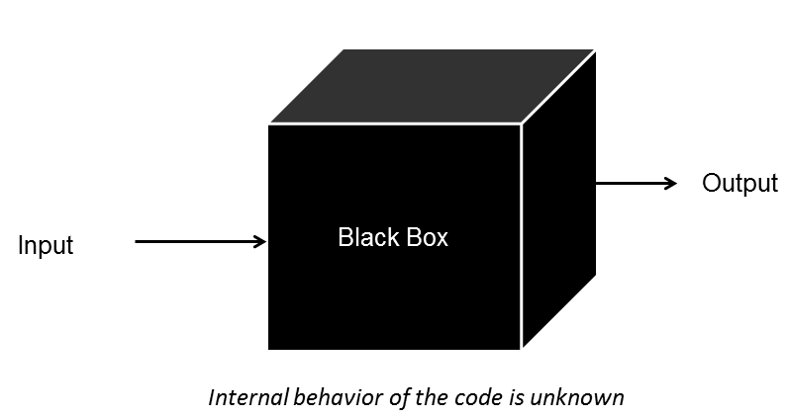
Functional (Black-box) testing
Tests that validate business requirements (what the system is supposed to do)
Test Engineers have no access to the source code or documentation of internal working.
Test cases are derived from the requirements specification of the software. No knowledge of internal program structure is used.

Slide 43
Question?

